Slide 1
Getting Started in Jupyter
Installation, Setup, and Resources

Slide 2
Outline
Installation
Anaconda
Verifying Jupyter installation
Accessing Jupyter
Next Steps

Slide 3
Definitions
Python: a programming language widely used for data science. Considered fairly beginner-friendly and highly adaptable to various tasks.
Jupyter Notebook: a file format and related editor that lets users combine Python code and analytical outputs in one document. Makes analysis in Python interactive, meaning that the results of each analytical step are easy to visualize, evaluate, and modify.
Anaconda: software that installs Python and packages like Jupyter Notebook in one clean, contained environment, simplifying maintenance and avoiding the need for administrator permissions on NYCHA machines.

Slide 4
Why Python/Jupyter?
Unlike drag-and-click tools like Excel, working in Python (or similar) allows you to record and reproduce every step in your analysis, so that you can:
Re-run an analysis on a new dataset
Easily adapt analytical workflows to different circumstances
Identify, explain, and defend individual analytical choices
Standard data analysis is easily combined with other capabilities of Python, including natural-language processing, record-linkage tools, and scripting to customize analytical logic and outputs
Jupyter makes analysis in Python interactive — i.e., you can examine your data and see the results of each analytical step right alongside your code

Slide 5
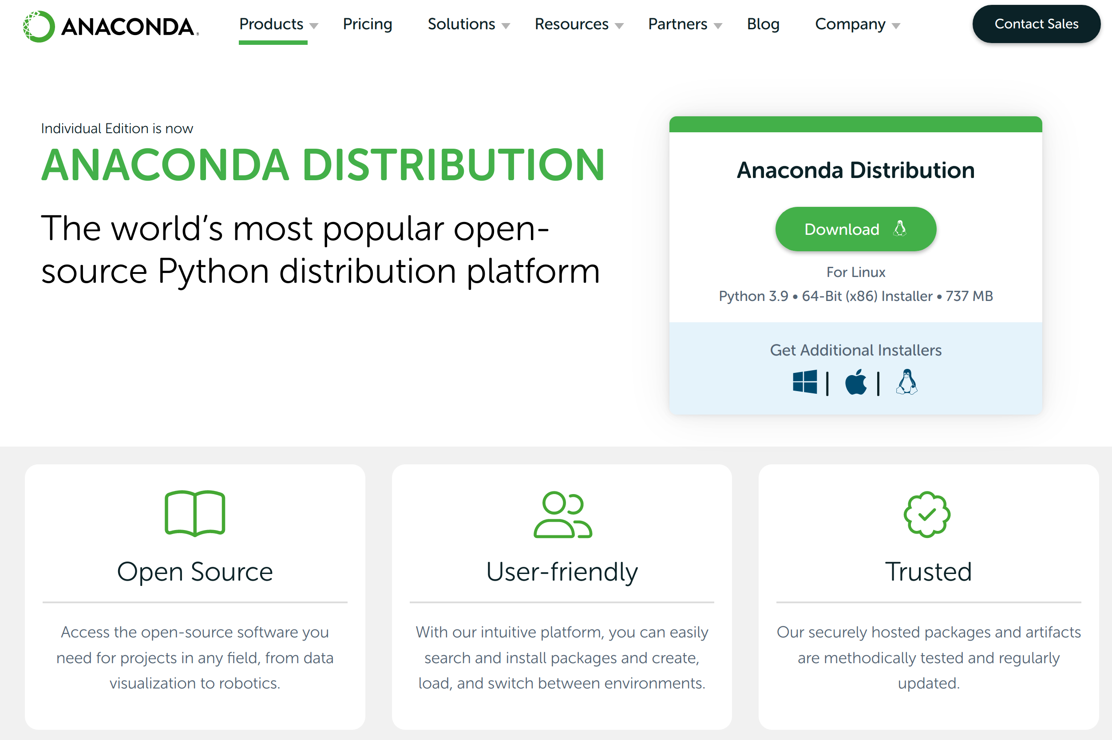
Anaconda: Installation
Python-forward platform for data science
Keeps Python installation and add-ons contained
Provides graphical interface for accessing programs and installing additional functionality
Works on NYCHA Windows machines without administrator privileges (at time of writing)
Installers and instructions available here
Detailed introduction to Anaconda available from creators here

Slide 6
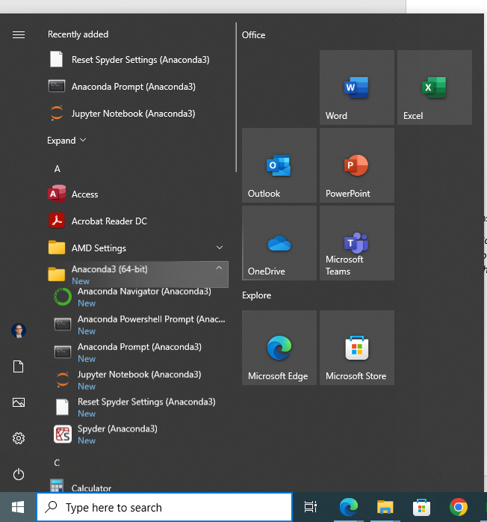
Anaconda: First Run
On Windows 10, key components are installed and available under the Start Menu
OSX: Installs under Applications folder
Linux: Varies by setup, but always accessible via command line
Multiple ways to run Anaconda:
Anaconda Navigator (GUI): click Jupyter Notebook or Jupyter Lab icon to get started
Anaconda Prompt (command line): enter the command “jupyter lab” or “jupyter notebook” to get started
Or, open Jupyter Notebook directly

Slide 7
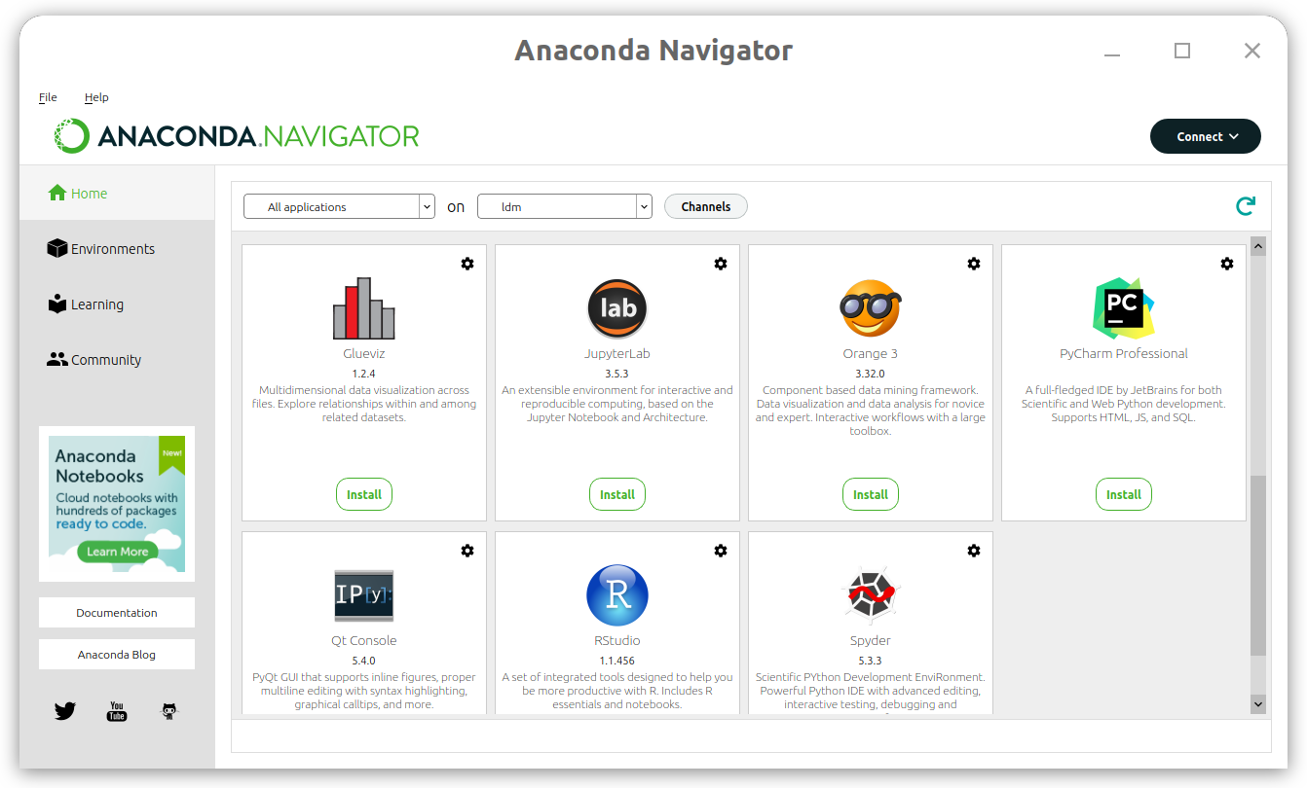
Anaconda Navigator
Applications can be installed or launched from the Home screen
Jupyter Lab: my preference (better interface, enables extensions)
Jupyter Notebook: core functionality only
Additional packages/libraries can be installed graphically under Environments
Generally, installing via comand line / Anaconda Prompt is simpler
See attached “Conda Cheatsheet” for useful commands

Slide 8
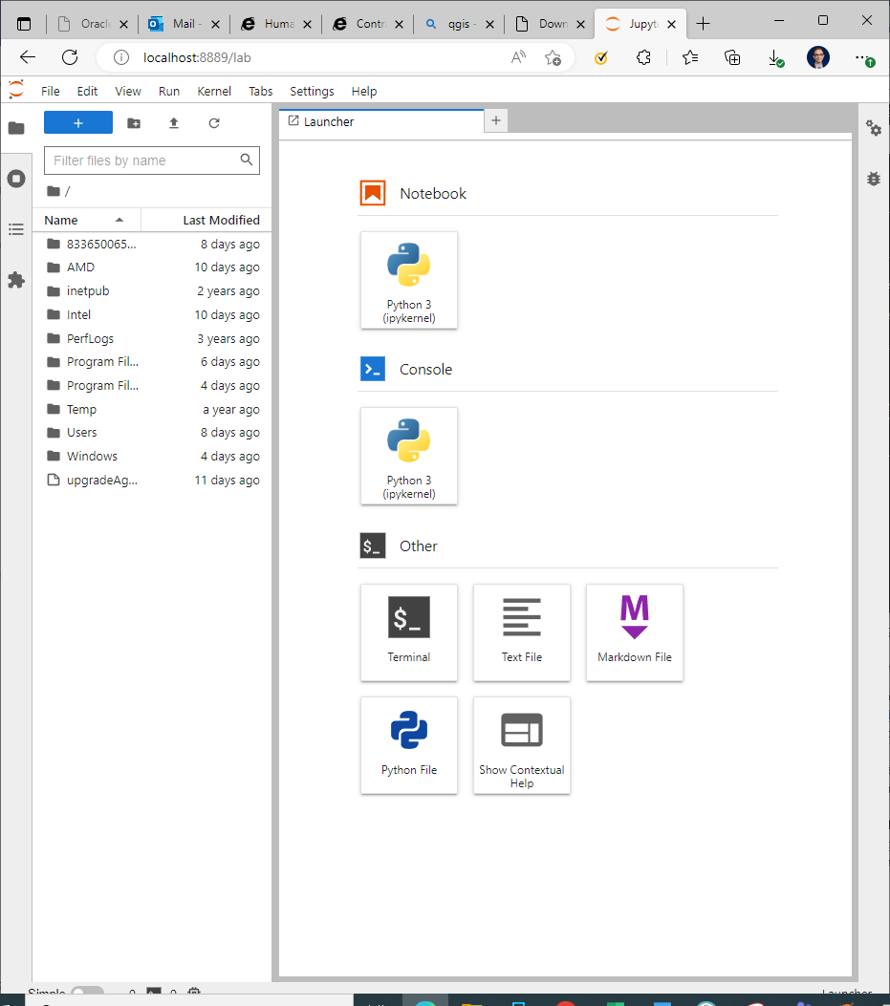
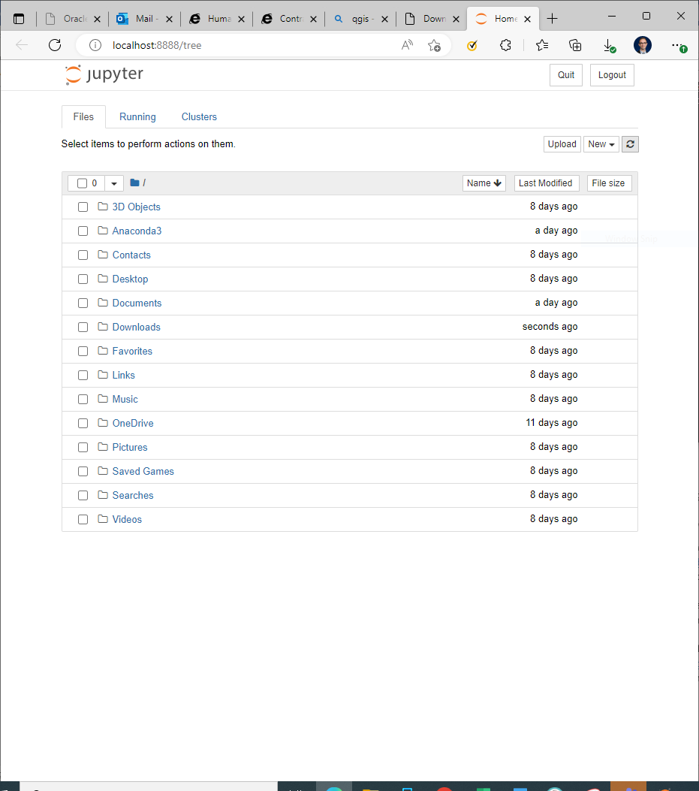
Jupyter Lab vs. Jupyter Notebook (use Lab!)

Slide 9
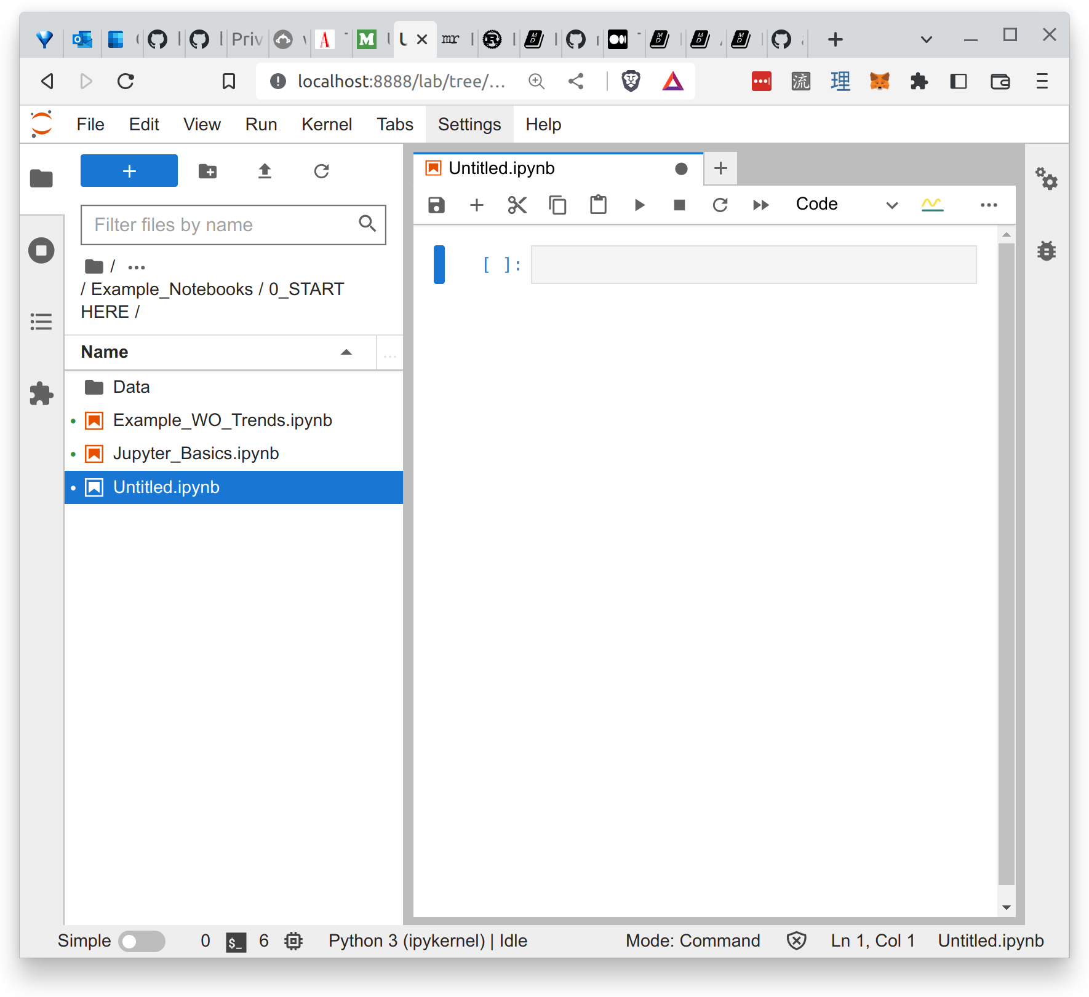
Jupyter Lab: Getting Started
If you’d like to experiment on your own, open a new Notebook from the screen shown on the last slide, and get typing!
For an introduction to Jupyter and recommendations on resources that will get you started on your Python journey, see the notebook “Jupyter_Basics.ipynb”
If you’re ready to jump into a sample data analysis using NYCHA data, see “Example_WO_Trends.ipynb”

